Slide 1




The Impact of Income Inequality on Education in Virginia
Presented by:
John Carl, Luke White, Molly McDade, & Ann Gray Perdue

Slide 2


Introduction
Background: Economic diversity is prevalent in Virginia with pockets of high income disparity across counties.
Problem Statement: "Does income inequality correlate with educational disparities in Virginia?"
Objective: Analyze data to uncover trends, relationships, and actionable insights regarding income and education inequality.
Business: This could allow the Virginia Department of Education to allocate school district resources by county to help students who are behind.
Notes:
Background: Virginia has economic diversity, with significant income disparities across counties.
Objective: Examine data to identify trends, relationships, and insights about income and education inequality.
Business: This will help the Virginia department of edu pinpoint certain counties to give resources to those students who are falling behind
Virginia has areas of both high wealth and significant poverty, creating a stark economic contrast across counties. This diversity can lead to differences in educational resources and access.
Where a student lives—and, by extension, the local income level—can impact the quality of their education. Higher income often correlates with better-funded schools, more resources, and a broader range of opportunities.
In this project, we analyze data to understand if and how income inequality drives these educational disparities in Virginia.

Slide 3

Data Source
VA Open Data Portals
Median Household Income
Standards of Learning (SOL) Test reports.
Simple Maps US Counties Database
Tools Used
MySQL
Alteryx
Tableau

Slide 4
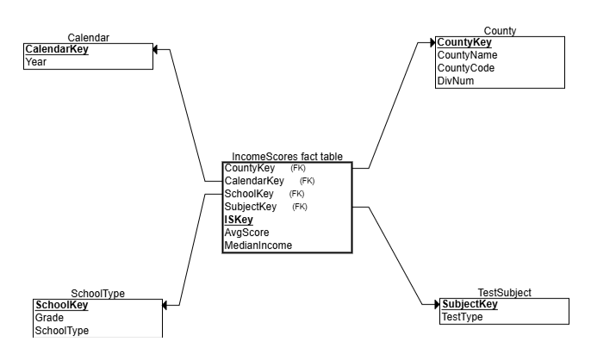
Dimensional Model Diagram
Initial

Slide 5
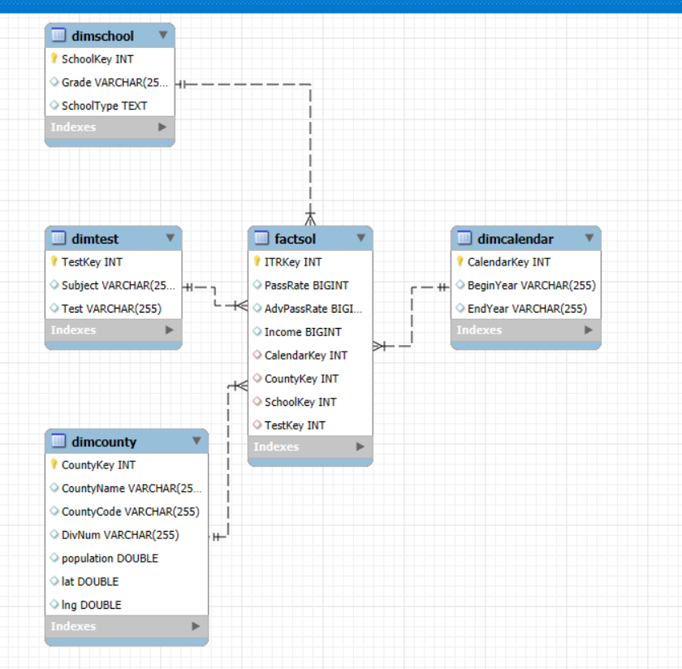
Final Dimensional Model Diagram

Slide 6

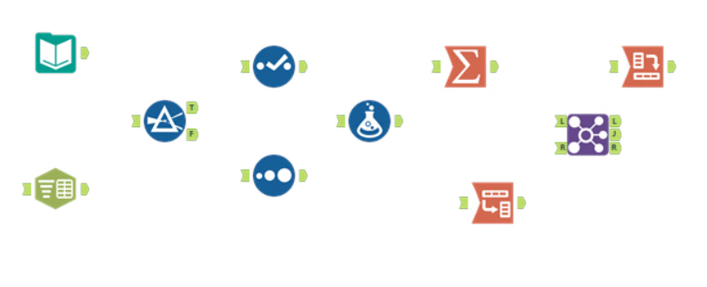


ETL PROCESS
Functions Used
Input Data
Select
Summarize
Cross Tab
Filter
Unique
Join
Text to Columns
Sort
Transpose
Record ID
Notes:
LW
We learned a ton about data wrangling with our datasets during the ETL process, these are some of the tools we used

Slide 7
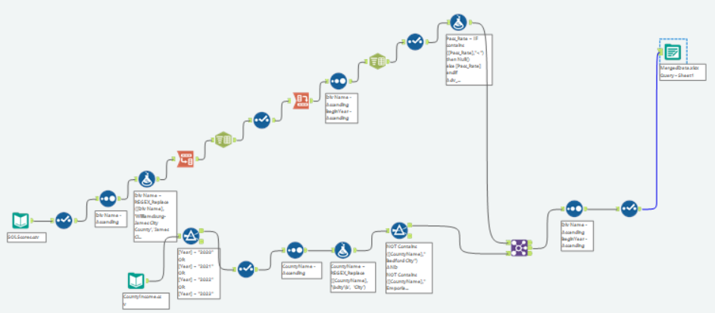
ETL Process Extraction & Transforming
This is our workflow for our transforming step. We inputted both of our data sources and made necessary changes to allow us to join our data sources to reach the joining process to then begin the loading process.
Notes:
LW
Our first step was loading in the SOL pass rate data and wrangling with it to make it useful. Our first formula was to remove a couple cities since they were already a part of county data and were redundant. Then we transposed the columns that combined year and pass rates into one into rows, parsed the rows, and did a cross tab to make them unique separate columns. We separated the years apart (since it was labeled by school term), and ran another formula to get rid of incomplete data entries (made them null).
Next we loaded in county information, filtered it to the years we had SOL rates for, renamed a couple cities to match the other dataset, and filtered out some redundant information. Finally, we joined the two on the county names and deselected unimportant information.

Slide 8
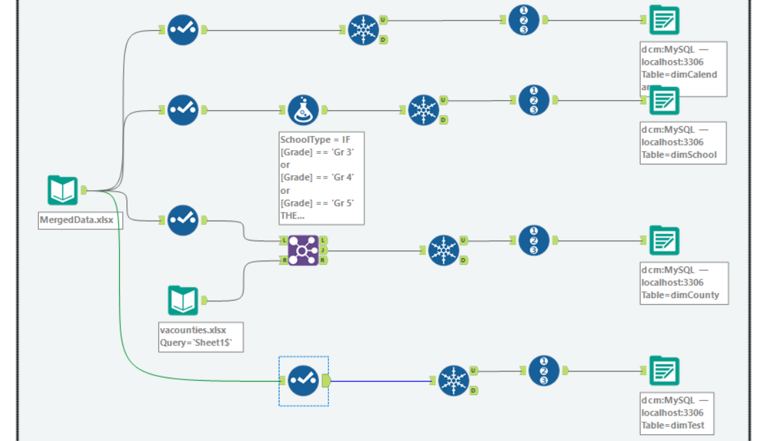
ETL Process Transforming & Loading
Dimensions
Data is organized and loaded into the data warehouse.
Notes:
LW
Next we created our dimensions calendar, school, county, and test. In our school dimension, we added a column to group grades into elementary, middle, and high school. Then we added county latitude and longitude information to our county dimension to use in tableau later.​

Slide 9
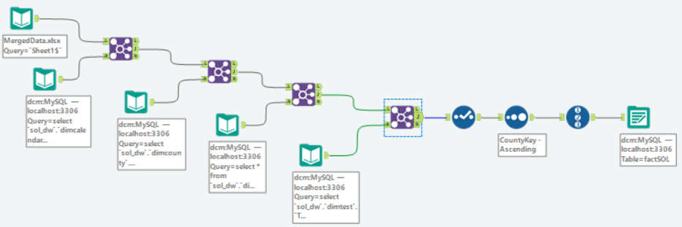
ETL Process Transforming & Loading
Fact Table
With our dimensions and keys created, we made our fact table that shows median income and sol pass rates and saved it to our SQL data warehouse
Notes:
LW
With our dimensions and keys created, we made our fact table that shows median income and sol pass rates and saved it to our SQL data warehouse ​

Slide 10
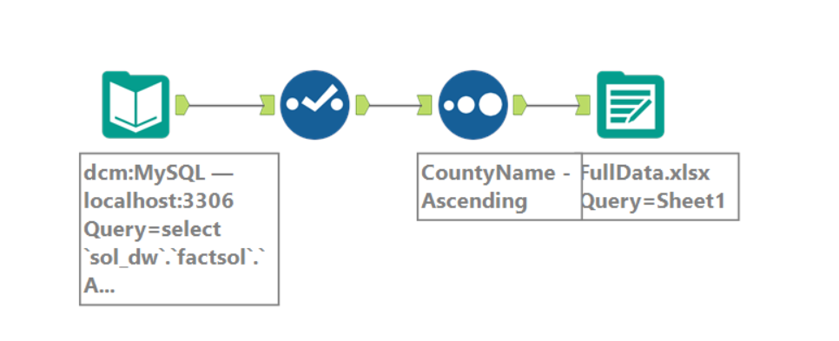
ETL Process Loading
Output for Tableau
This extra step allowed us to create a sheet with all the data which was helpful for the looking at everything into tableau.
Notes:
LW
Lastly, we exported all relevant information to an excel sheet to use in tableau

Slide 11
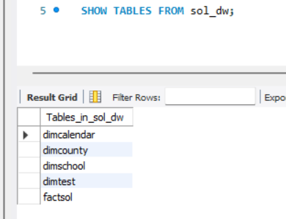
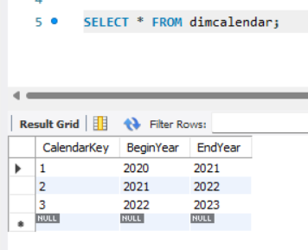
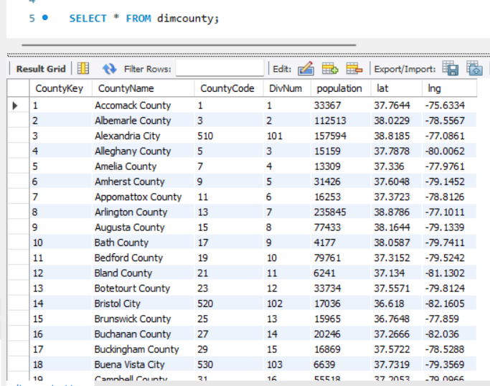
SQL Database
Our database (sol_dw) is composed of a fact table (factsol) and four dimensions: Calendar (dimcalendar), County (dimcounty), School (dimschool), and Test (dimtest).
For our calendar dimension, the dataset is composed only of yearly dates. Since it is a school year, there will be the year the term began in, and the year it ended in.
For our county dimension, we have the name of the county, the county and division code, population, and latitude/longitude.
Keys were created for all dimensions for the fact table

Slide 12
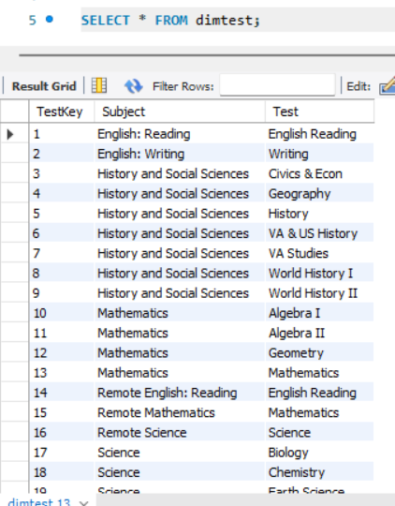
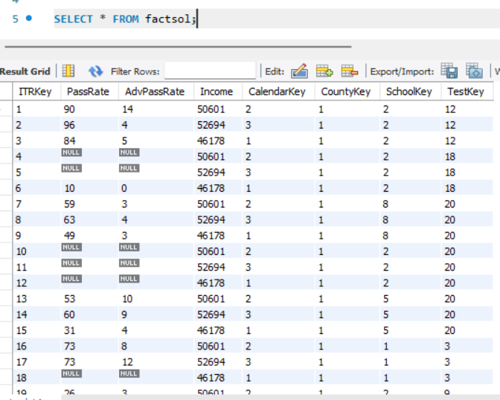
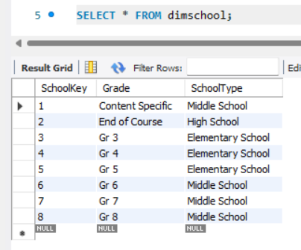
SQL Database
For our school dimension, we have each grade level, and a calculated column grouping them into school type (elementary, middle, high school).
For our test dimension, we have each test with its corresponding subject. Subject is important to include because of remote classes.
For our SOL fact table, the pass rate, advanced pass rate, and median income is recorded along with all foreign keys to dimensions.

Slide 13
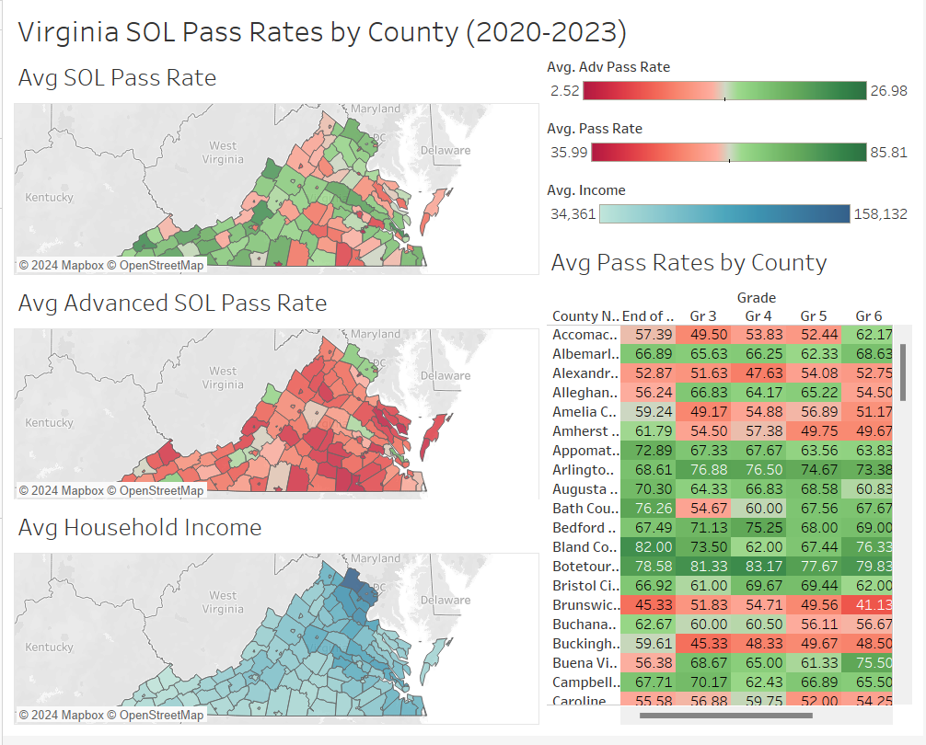
Tableau
Analysis
Our analysis showed that income and SOL pass rates did not appear to be aligned
However, it appears in areas with higher average household income, there are higher average advanced pass rates

Slide 14
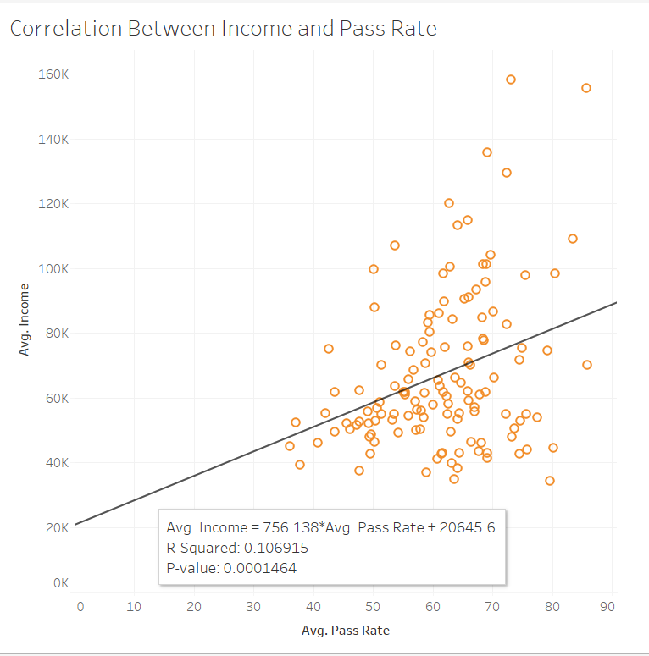
Tableau
Analysis
We created a scatter plot to see if there was a correlation between income and overall pass rate
The R squared of 0.11 did not suggest a strong correlation, and most scores gravitated around a passing score of 50-60% for all incomes

Slide 15
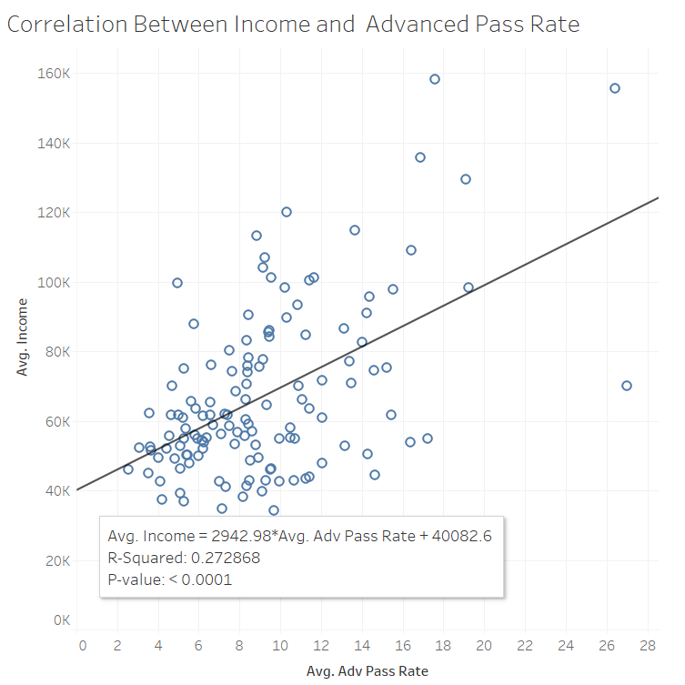
Tableau
Analysis
We created a scatter plot to see if there was a correlation between income and advanced pass rate
The R squared of 0.27 did not suggest a strong correlation, however, there appears to be some sort of trend / interaction that could be explained by a model with more variables

Slide 16
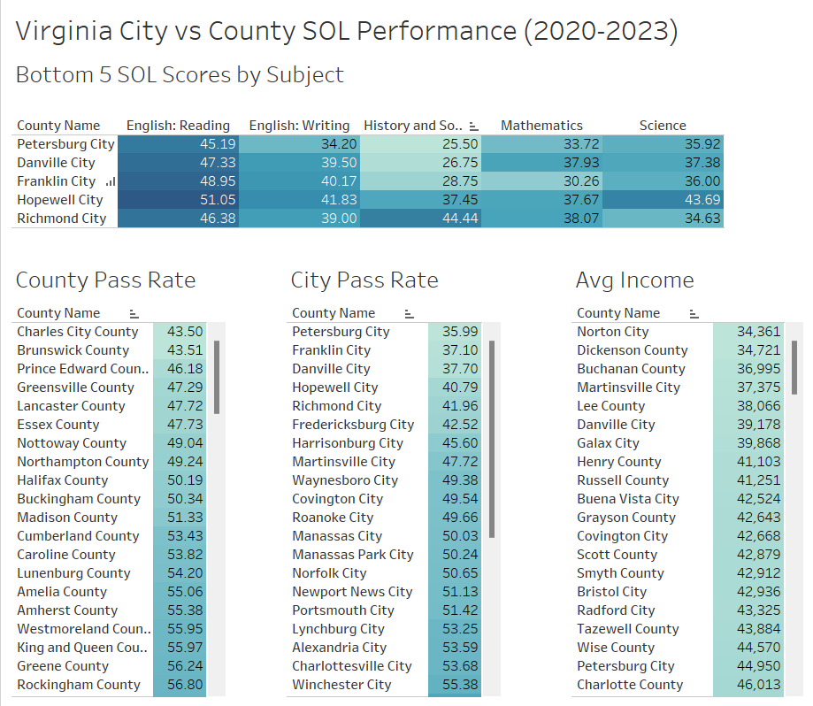
Tableau
Analysis
Our analysis showed that cities performed worse than counties on SOL pass rates
The bottom 5 school districts were all cities, with the majority of their worst SOL scores in history and social studies
While cities had lower income than counties, there still seemed to be little alignment between overall pass rates and income

Slide 17


Conclusion
Challenges Encountered:
Our primary challenge was data quality. A significant portion of our time was dedicated to cleaning and transforming the data into a user-friendly format suitable for analysis and visualization.
Easiest Steps:
After building the dashboards, generating actionable insights became straightforward, highlighting the importance of having a clean, reliable database or data warehouse to support efficient decision-making.

Slide 18
Conclusion
Lessons Learned:
Initially, we assumed a direct relationship between income levels and test scores: higher income would align with higher scores, and vice versa. However, our analysis revealed this was not the case, challenging our initial expectations and offering new perspectives on educational performance factors.
Do-Over Reflections:
With more time, we would explore other potential influences on SOL (Standards of Learning) performance to identify the primary factors impacting student outcomes.

Slide 19
Conclusion
Proposed Benefits Realization:
The new system has enabled faster, data-driven insights by providing streamlined access to cleaned and structured data. This capability supports more informed decision-making regarding income and educational performance.

Slide 20
Conclusion
Final Comments and Conclusions
Reflections on Project Impact:
This project has underscored the importance of data preparation and critical examination of assumptions. Our analysis emphasized that effective ETL processes are foundational to gaining accurate, actionable insights.
Future Recommendations:
For future projects, we recommend dedicating more time to investigating diverse data sources that might reveal other influences on educational outcomes, beyond income levels alone.

